Slide 1

Adaptive Charging Network for electric vehicles
George Lee
Steven Low
March 2017
Notes:
PowerFlex is a Caltech startup co-founded by George Lee and Steven Low
Dec 9, 2016: GlobalSIP, Washington DC (invited Meng Wang)
March 30, 2017 NSF: Barbara Kenny, Prakash Balan AIR PM, Arlington, VA

Slide 2
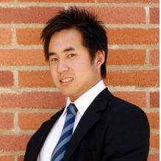
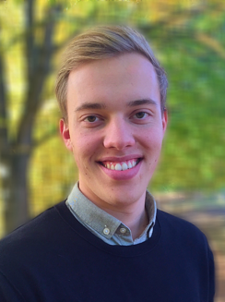

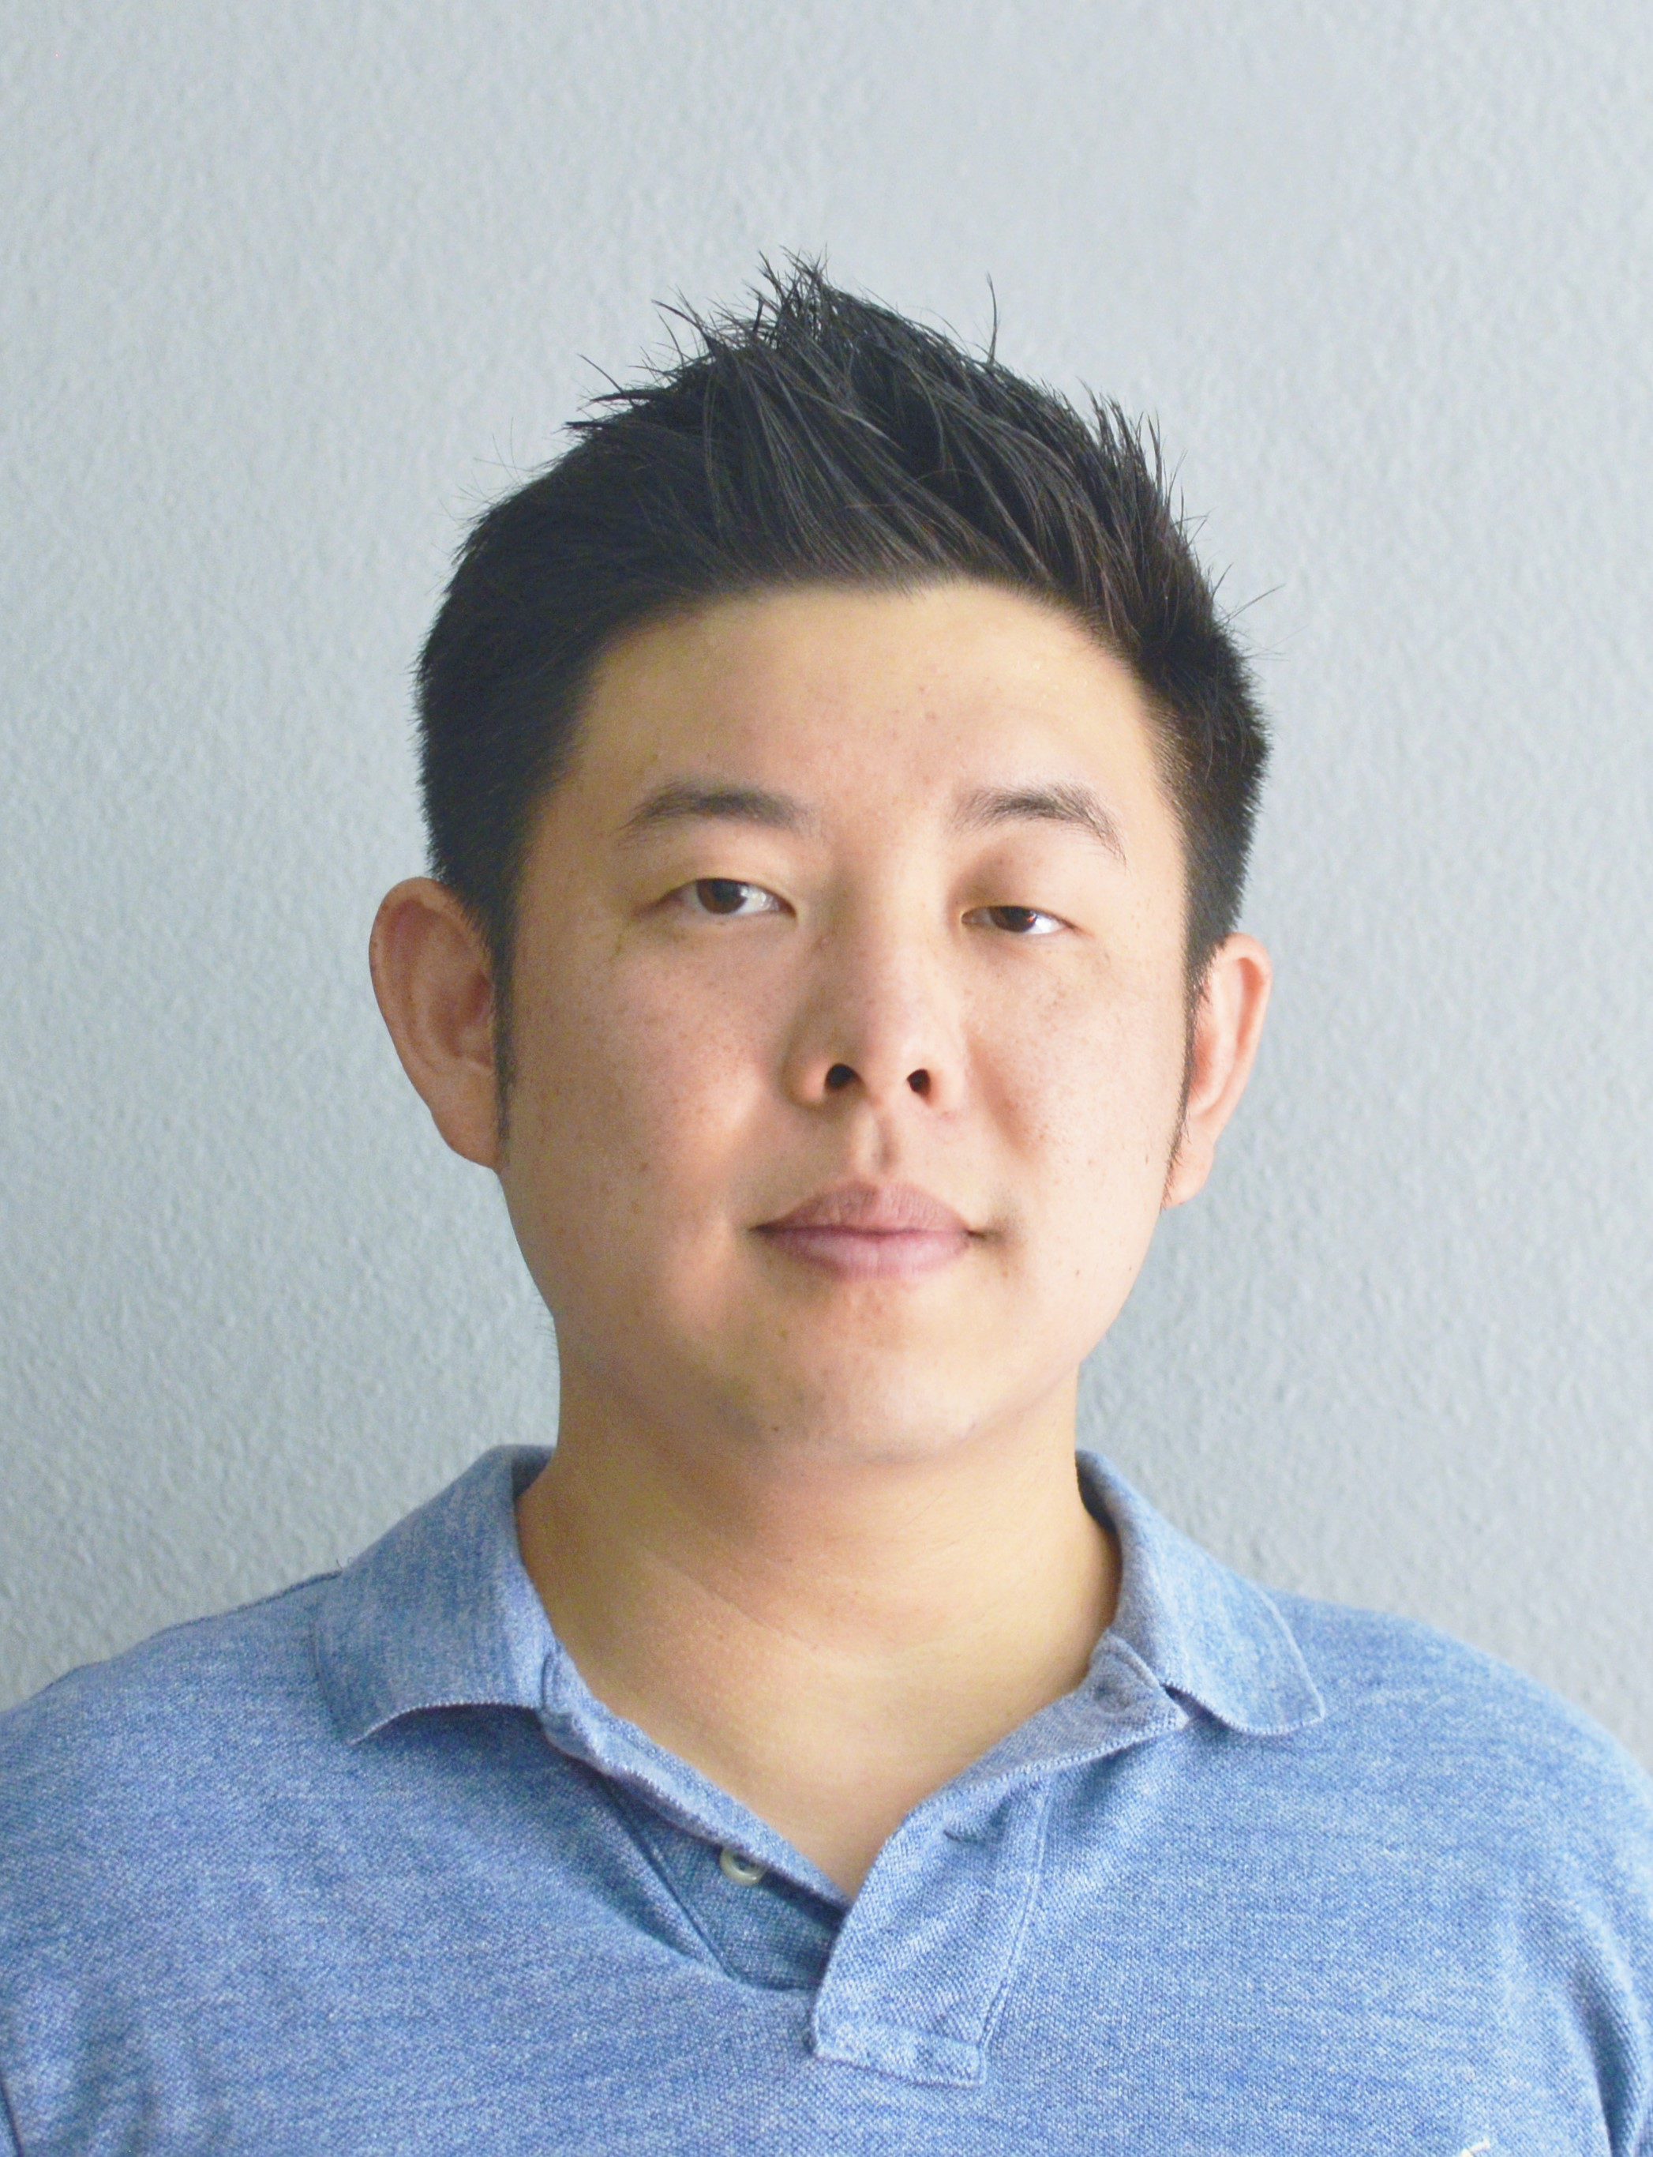
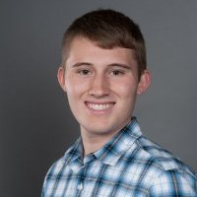
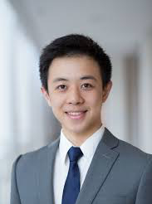



ACN testbed
D. Chang, CIT
K. Erliksson, Lund
R. Lee, CIT
T. Lee, CIT
Z. Lee, CIT
Z. Low, Cornell
C. Ortega, CIT

Slide 3
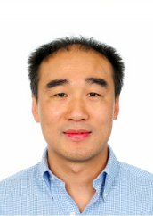
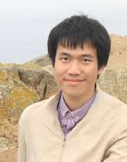


ACN theory
L. Chen, Colorado
L. Chen, CIT
D. Guo, CIT
Y. Nakhira, CIT

Slide 4
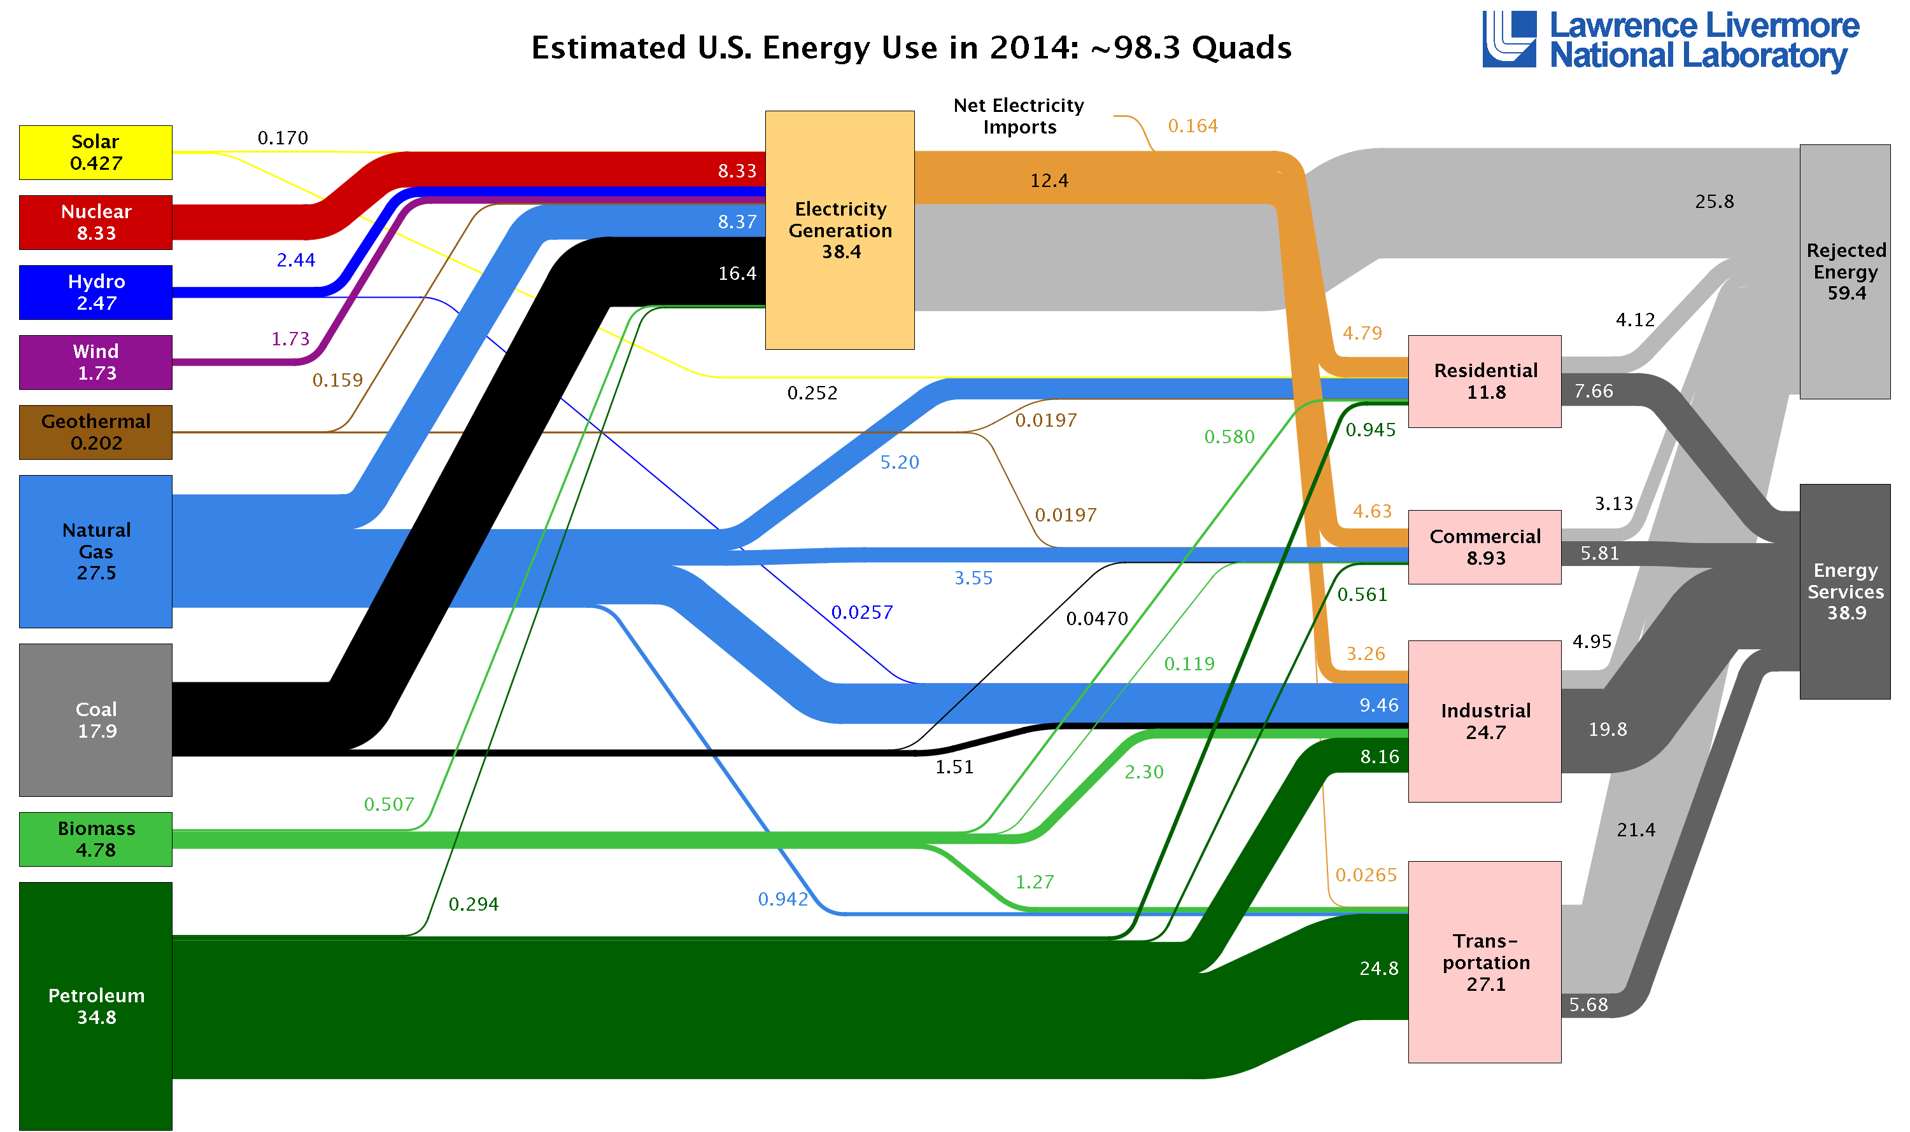
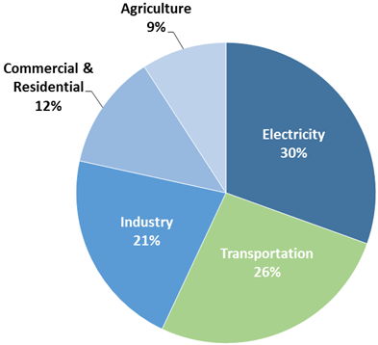
Electricity gen & transportation
They consume the most energy
Consumer 2/3 of all energy in US
They emit the most greenhouse gases
Emit >1/2 of all greenhouse gases in US
To drastically reduce greenhouse gases
Increase renewable generations
Electrify transportation

Slide 5
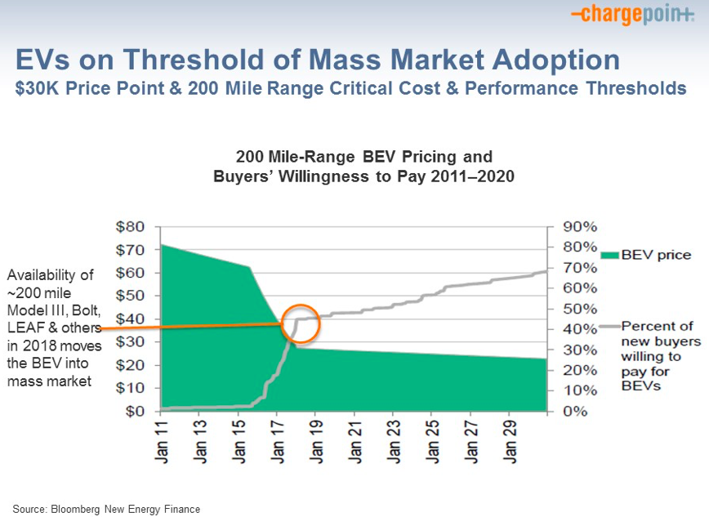
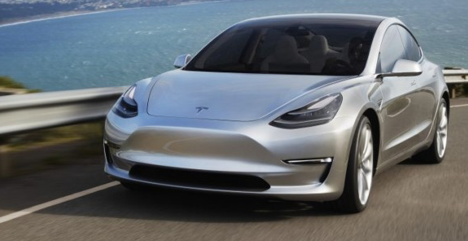
EV & charging
Tesla Model 3 (4/2016)
source:
Chargepoint
1st week reservation:
325K, $14B
CA 2025 goal
1.5 million zero emission cars
Accelerating growth
2011-2013: EVs have grown by 8x in US
2011-2013: #Public charging stations grown by 7x in US
Painpoints
Overcrowding, EV shuffling

Slide 6
Publications
Adaptive Charging Network for Electric Vehicles. Dec 2016
George Lee, Ted Lee, Zhi Low, Steven H. Low and Christine
Ortega, IEEE GlobalSIP, Washington, DC
Smoothed Least-laxity-first Algorithm for EV Charging. May 2017. Y. Nakahira, N. Chen, L. Chen and S. H. Low.
Proc ACM e-Energy Conference, Hong Kong
Optimal Online Adaptive Electric Vehicle Charging. July 2017
Linqi Guo, Karl F. Erliksson and Steven H. Low.
Proc. IEEE PES General Meeting, Chicago, IL
The National Electric Transportation Infrastructure Working Council (IWC) Meeting, San Francisco, CA, November 2016

Slide 7
Outline
Theory and algorithms
Algorithm design
Simulations and analysis
ACN testbed
System design
Caltech pilot

Slide 8
Charging model
energy
demand
(miles / kWh)
arrival /
departure
time
peak
charging
rate (kW)

Slide 9
Charging model

Slide 10
Offline optimal charging
Offline optimal problem is a linear program
charge only after a_{i} before d_{i}
not exceeding peak rate

Slide 11
Offline optimal charging
Offline optimal problem is a linear program
meet energy demand
not exceed limit;
can generalize to
linear constraints

Slide 12
Online LP
Offline LP is not implementable
It needs future EV information
Implement Online LP
Solve LP with current EVs, assuming no future arrival
Update remaining energy demand after each online LP iteration
Model-predictive control

Slide 13
Performance: online LP
Suppose cost coefficients are uniformly monotone
Theorem
If online LP is feasible, then it attains offline optimal
Guo, Erliksson, L. PES GM 2017

Slide 14
Performance: online LP
Theorem
competitive ratio can be arbitrarily bad
Guo, Erliksson, L. PES GM 2017

Slide 15
Performance: online LP
feasibility of online LP
~ feasibility of offline LP
normalized difference
normalized difference
(averaged over all locations
and all days for each dataset)

Slide 16
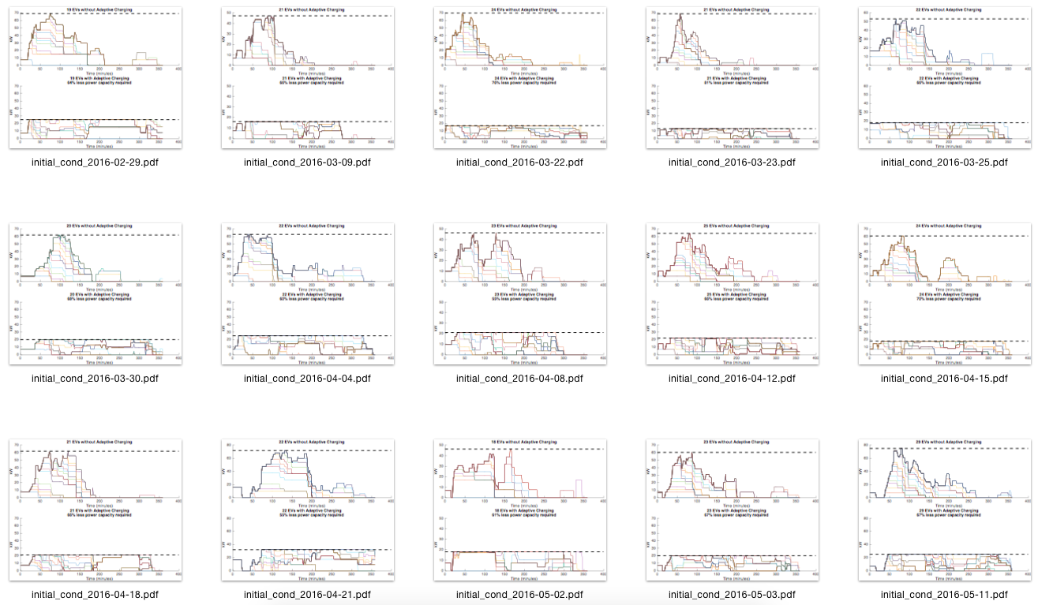
Performance
data: g2016mtv2000
data: CAgarage2016
peak demand reduction
Caltech data (Feb – May, 2016)
savings = infrastructure, demand charge

Slide 17
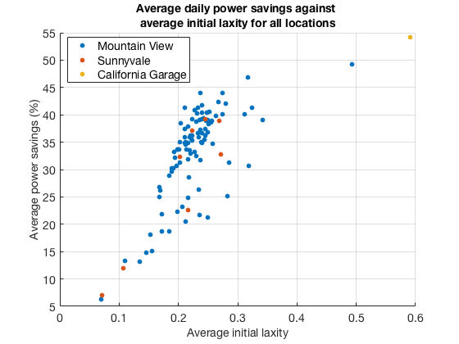
Adaptive charging network
Daily peak power | Uncontrolled charging | ACN | Power savings
Caltech | 85.3 kW | 33.8 kW | 60%
Mountain View | 46.2 kW | 28.4 kW | 34%
Sunnyvale | 94.0 kW | 56.2 kW | 29%
savings = infrastructure, demand charge
Conclusions
savings increase in initial laxity
significant savings even at low laxity
Karl Erliksson 2016 SURF
Notes:
The transformer capacity is 7.2 kW (25 kW shared between 4 houses). Each car can charge at a peak rate of 7.2 kW. Therefore all three cars charging at their peak rate will exceed the transformer limit.
The demo will run over 11 minutes with the following scenario:
Three cars will be plugged in at different times with different energy demands and departure times:
Car 1: arrives at time 0, departs at time 11 mins, needs 0.71 kWh.
Car 2: arrives at time 2 mins, departs at 5 mins, needs 0.36 kWh.
Car 3: arrives at time 3 mins, departs at 8 mins, needs 0.25 kWh.
The scenario is designed to illustrate the importance of smart charging (and other system functions; see below):
Dumb charging where each car charges at its peak will exceed transformer limit.
Static sharing policy will not satisfy EV energy demands.
Only dynamic adaptation based on real-time information can work, as shown in the diagram below.

Slide 18
Data cleaning
Remaining #EVs (charging sessions)
Mountain View: 44,587
Sunnyvale: 6,466
CA Garage: 1,309
Total: 52,362 sessions, in 2016 (over a few months)
104 locations
>4,000 charging days
Notes:
The transformer capacity is 7.2 kW (25 kW shared between 4 houses). Each car can charge at a peak rate of 7.2 kW. Therefore all three cars charging at their peak rate will exceed the transformer limit.
The demo will run over 11 minutes with the following scenario:
Three cars will be plugged in at different times with different energy demands and departure times:
Car 1: arrives at time 0, departs at time 11 mins, needs 0.71 kWh.
Car 2: arrives at time 2 mins, departs at 5 mins, needs 0.36 kWh.
Car 3: arrives at time 3 mins, departs at 8 mins, needs 0.25 kWh.
The scenario is designed to illustrate the importance of smart charging (and other system functions; see below):
Dumb charging where each car charges at its peak will exceed transformer limit.
Static sharing policy will not satisfy EV energy demands.
Only dynamic adaptation based on real-time information can work, as shown in the diagram below.

Slide 19
Smoothed Least laxity first (sLLF)
energy
demand
(miles / kWh)
arrival /
departure
time
peak
charging
rate (kW)
no look-ahead

Slide 20
Smoothed Least laxity first (sLLF)
energy
demand
(miles / kWh)
arrival /
departure
time
peak
charging
rate (kW)
remaining
time
minimum
required

Slide 21
Smoothed Least laxity first (sLLF)
Algorithm: max min laxity at next time
Nakahira, et al, e-Energy 2017

Slide 22
Smoothed Least laxity first (sLLF)
Theorem
sLLF rates solves
➔ water-filling algorithm
Nakahira, et al, e-Energy 2017

Slide 23
Smoothed Least laxity first (sLLF)
Theorem
sLLF rates are
Proportionally fair
Maxmin fair
Nakahira, et al, e-Energy 2017

Slide 24
Smoothed Least laxity first (sLLF)
Nakahira, et al, e-Energy 2017

Slide 25
Outline
Theory and algorithms
Algorithm design
Simulations and analysis
ACN testbed
System design
Caltech pilot

Slide 26
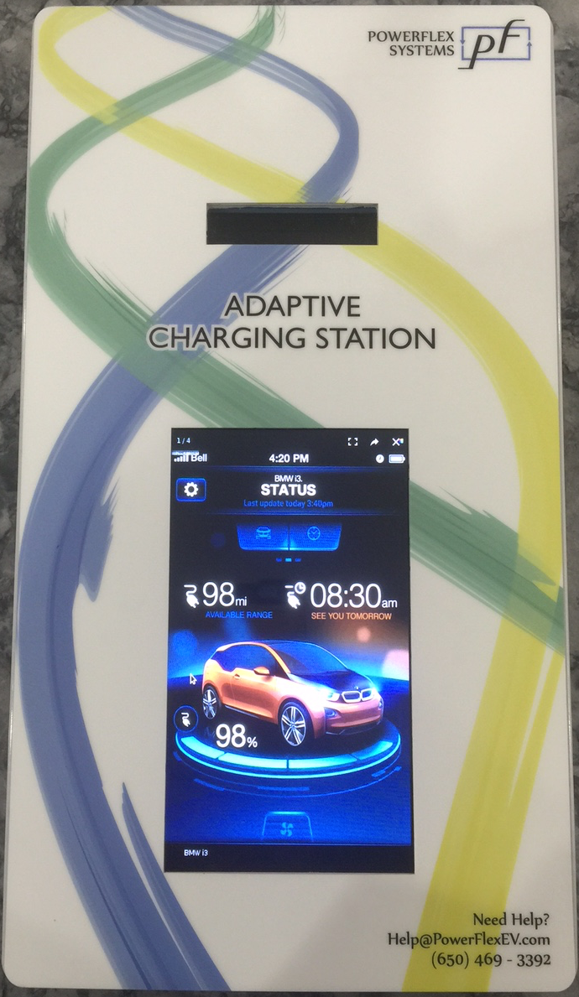

Overall system
utility
company
Caltech
substation
480V
800A
main switch
panel
garage loads
(lighting, fans, etc)
480V
225A
150 kVA EV
3-phase
transformer
208V
500A
EV switch
panel
EV switch
panel
Caltech
ACN
208V
80A
charger
…
…

Slide 27
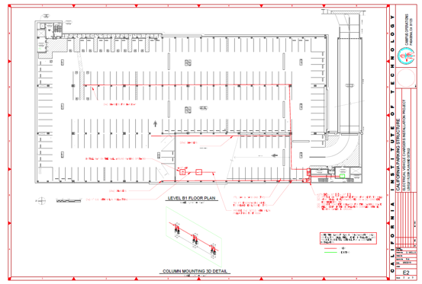
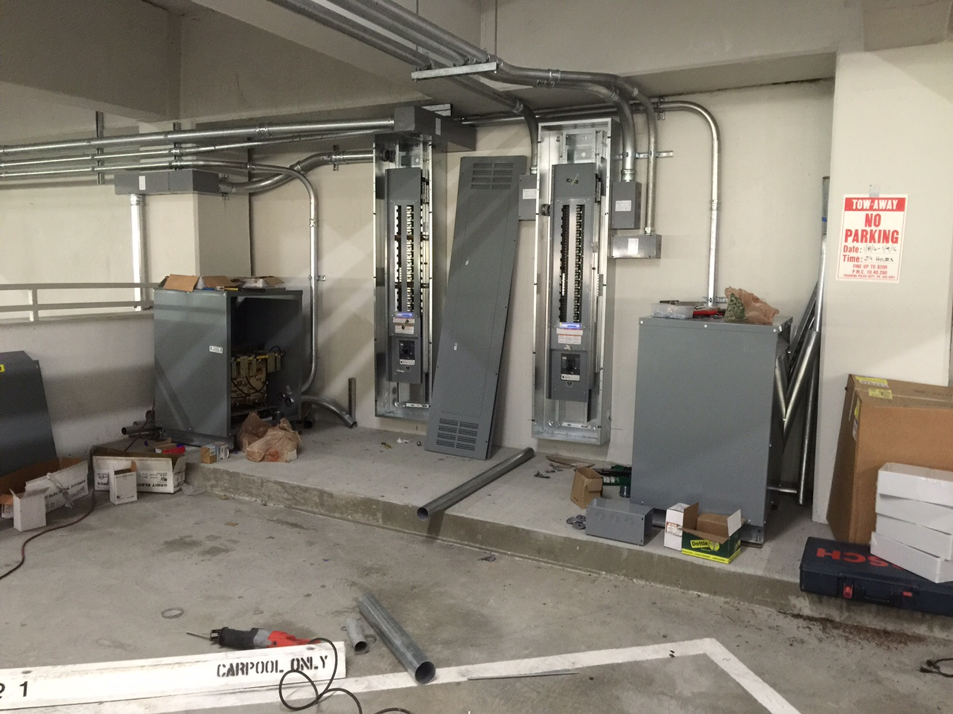
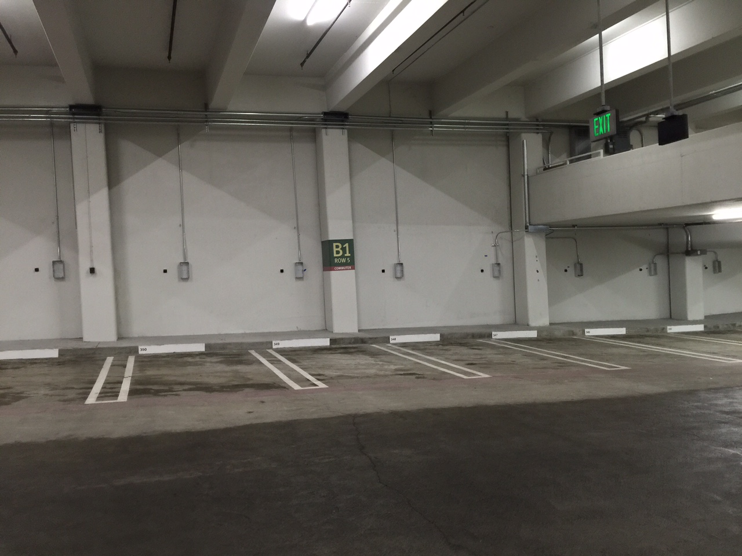
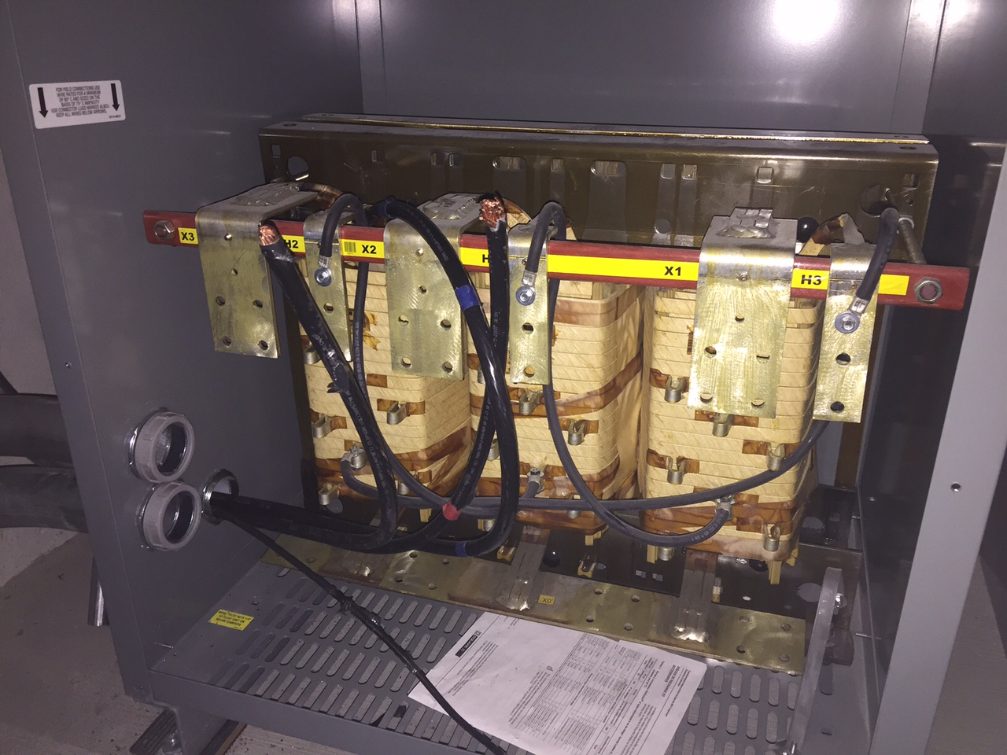
Adaptive charging network
First pilot @Caltech garage
50+ adaptive Level 2 chargers
2x 150kVA transformers
Operational since Feb 2016
main panel
chargers
150kVA transformers
debugging

Slide 28
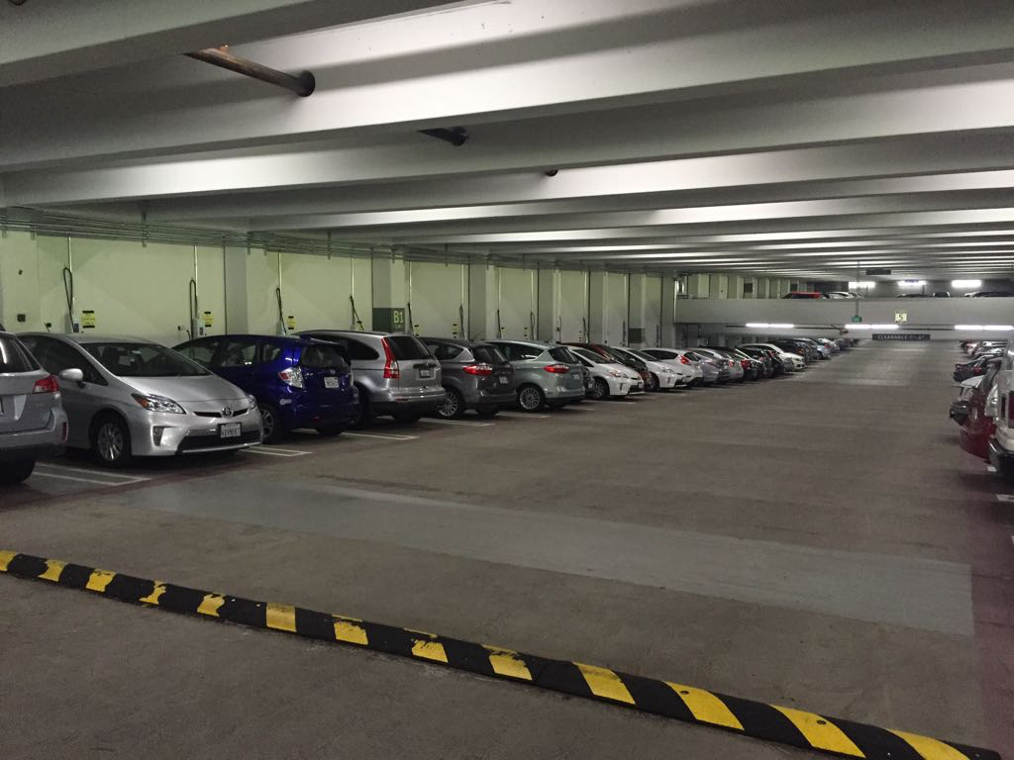
Caltech ACN
Provide target charging capacity at much lower infrastructure & operating costs (30% - 60% savings)
Provide ancillary energy services
(60 chargers; since 2/2016; 400K+ miles delivered, 140+ tons of GHG avoided; 3/2017)

Slide 29
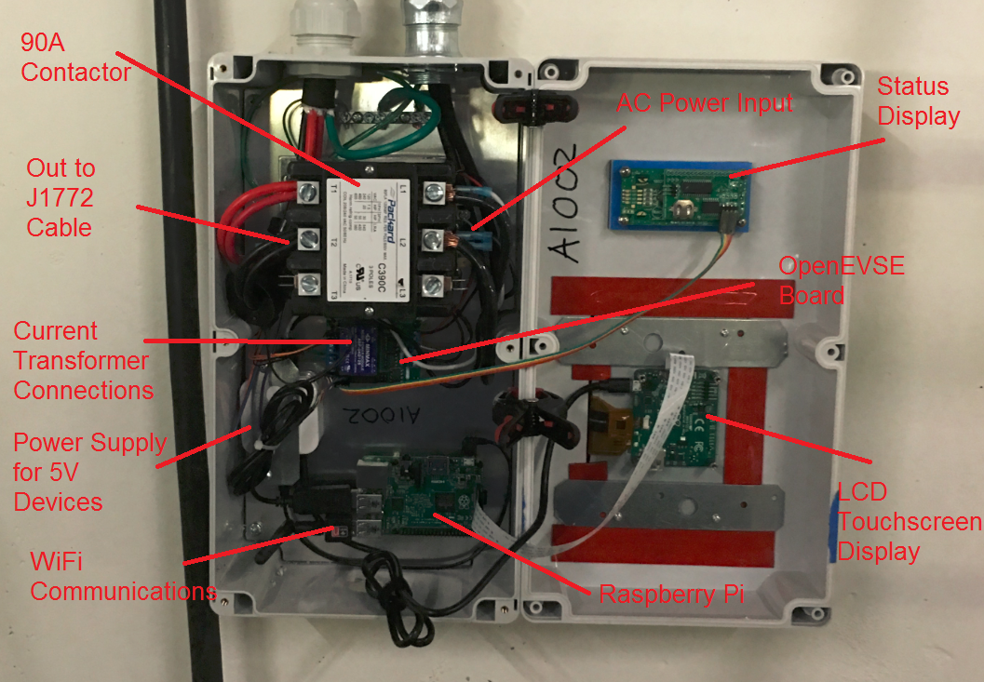
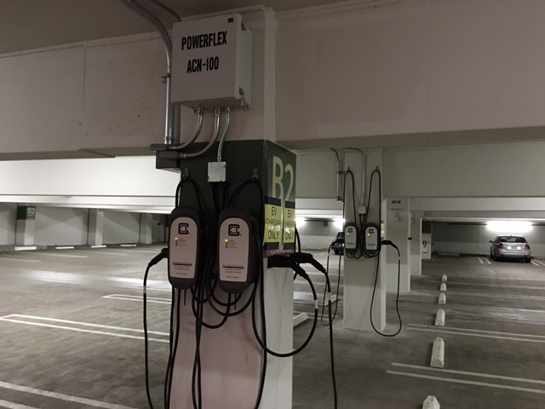
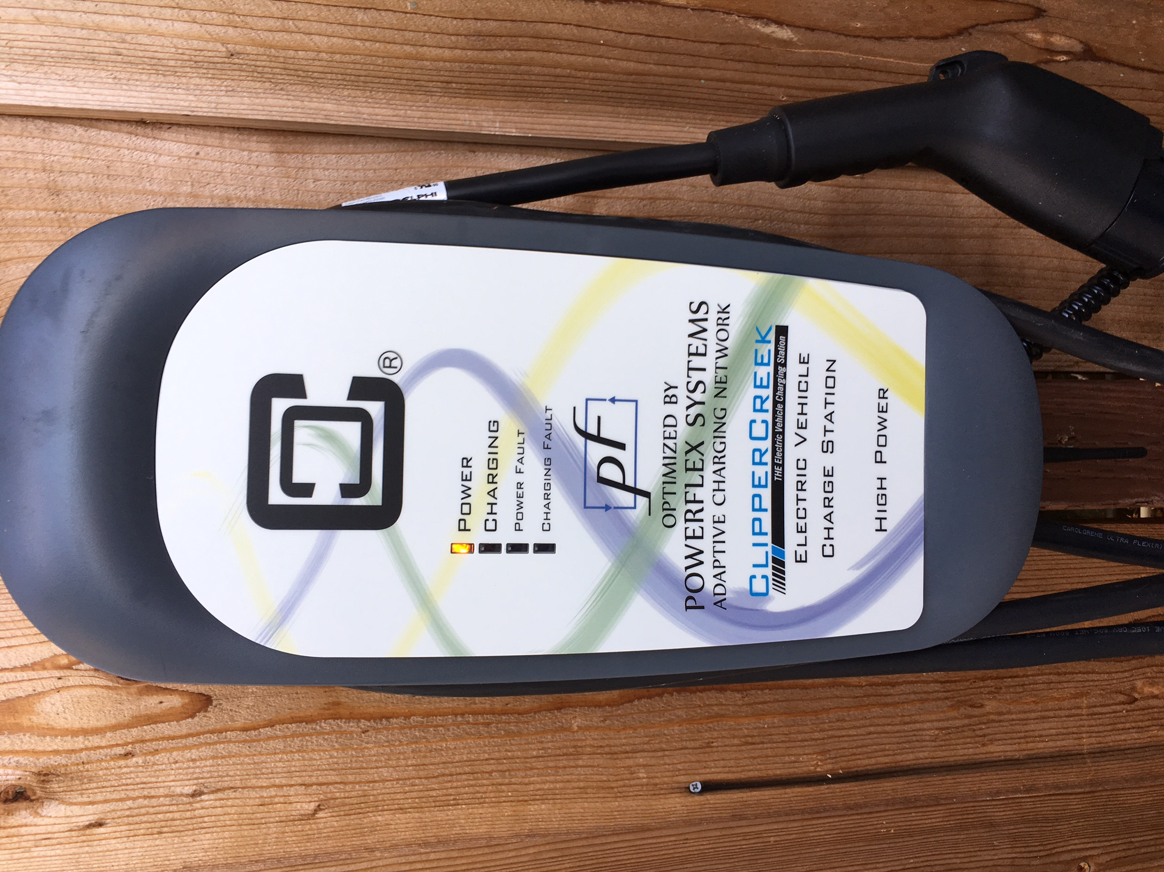
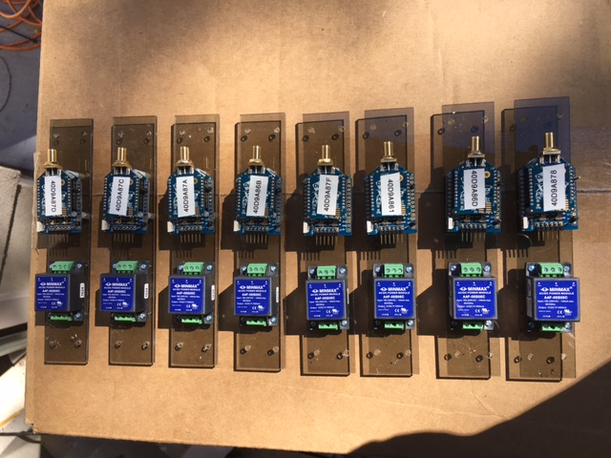
Hardware design
cloud
network

Slide 30



Software design
learning &
prediction
alerts &
visualization
station &
subscription mgt
servers
database
communication & interfaces
control &
optimization
(LMC)
wireless & wireline network
OpenADR
2.0
OpenADR 2.0
mobile
app
facility
operator
utilities
ISO

Slide 31
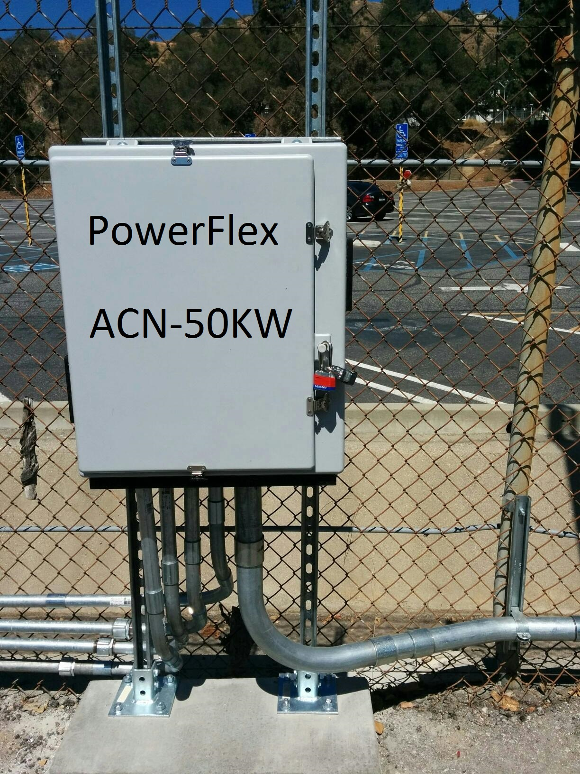
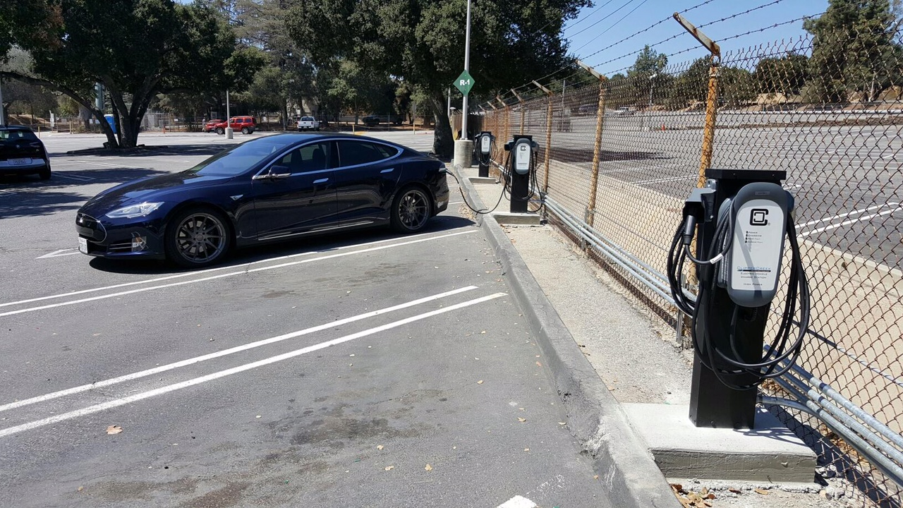
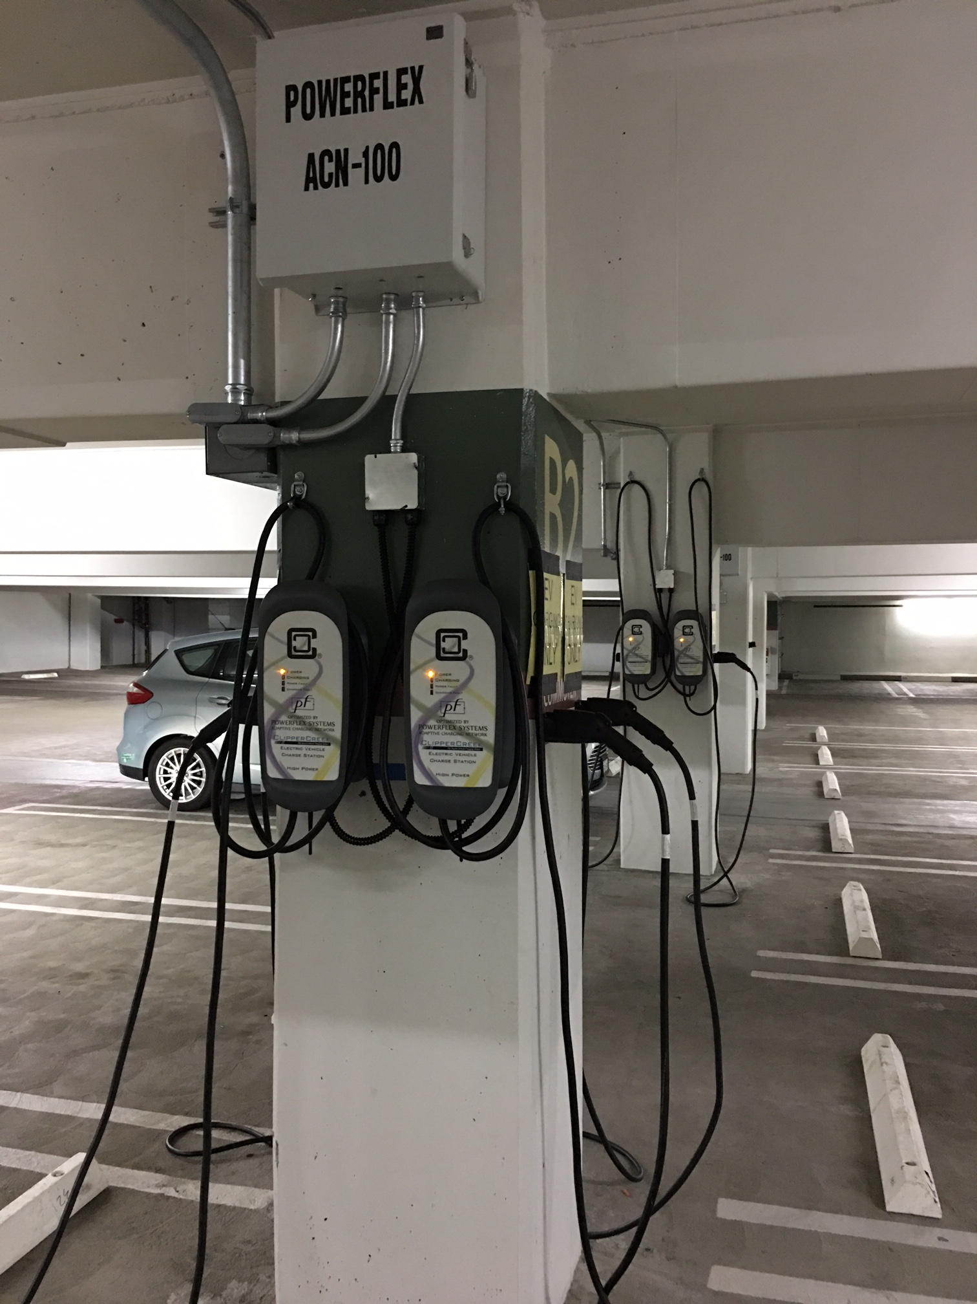
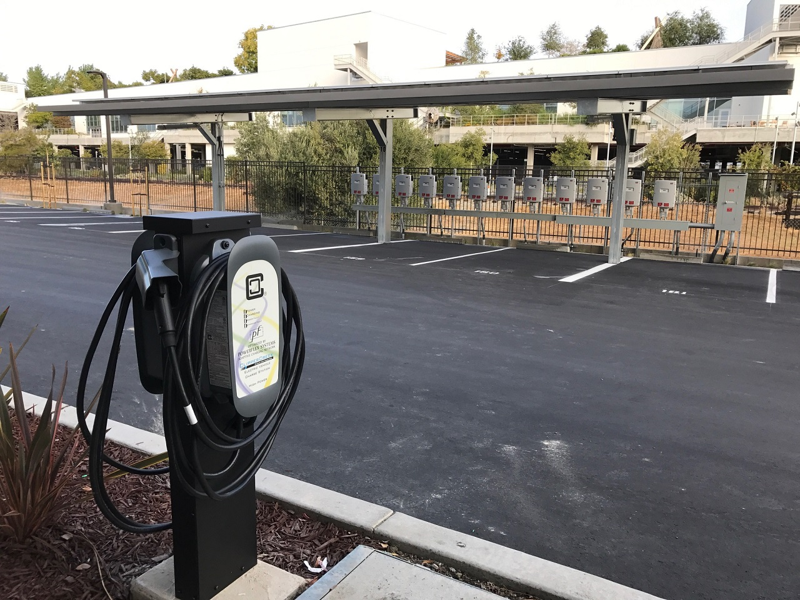
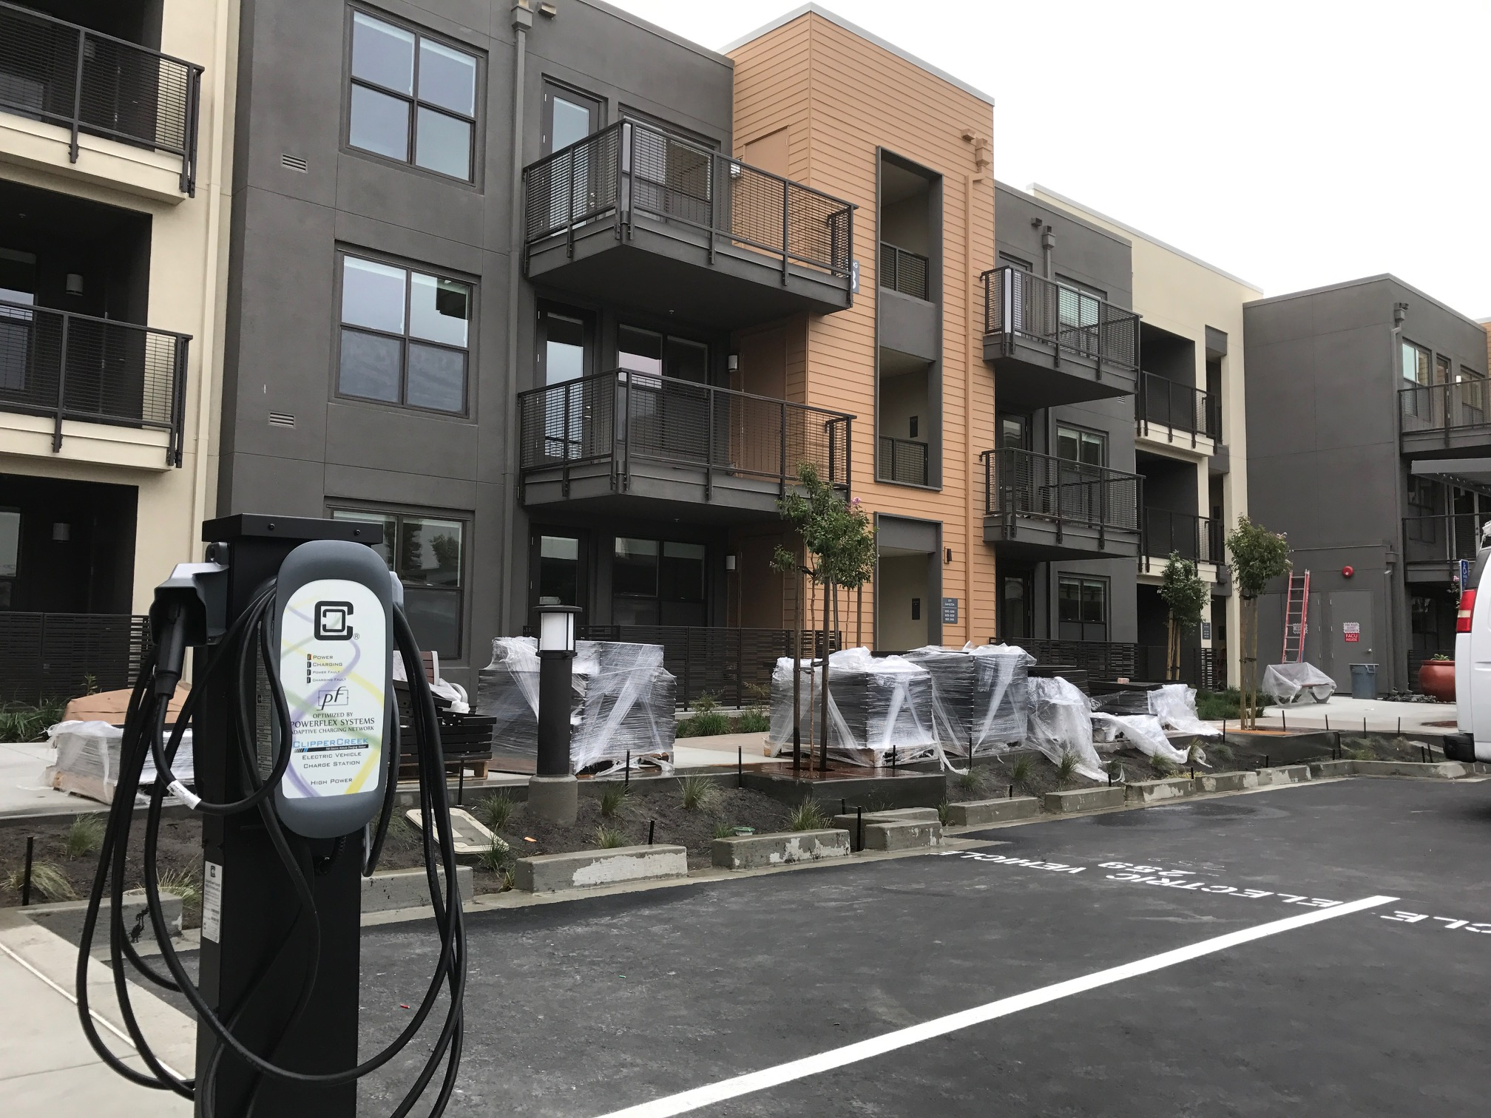
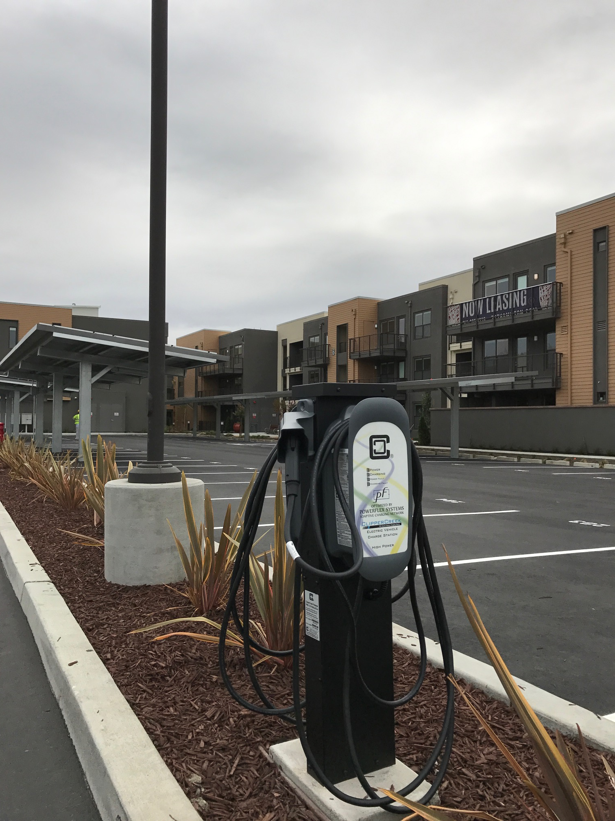
Indoor or outdoor

Slide 32
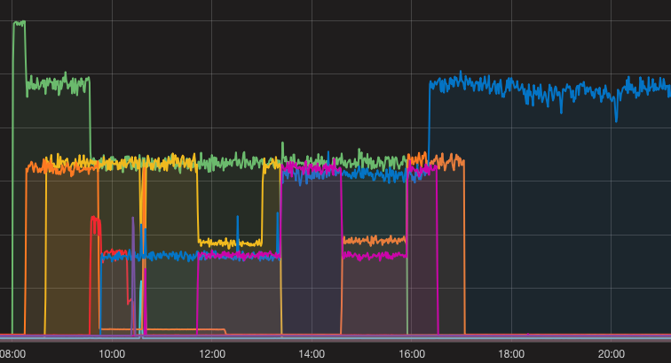
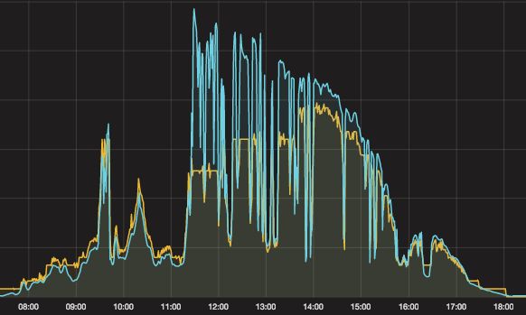
Adaptation
30A
24A
16A
Fair sharing, Aug 2016
Real-time adaptation
8A
PV
charging rate
(EVSE)
DR capability, Oct 2016
Capability to track PV
generation in real time
JPL demo

Slide 33
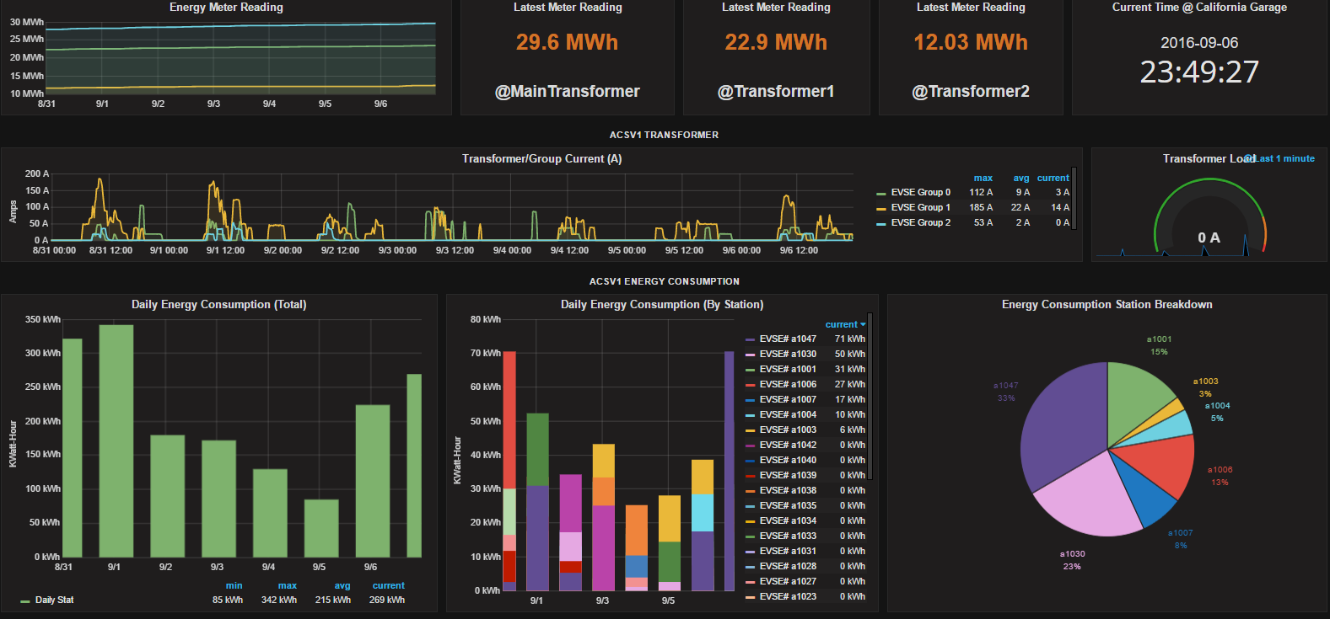
Management interface
Real-time monitoring
Deployed on ACN cloud server

Slide 34
Key benefits
Provide target charging capacity at 30%-60% lower costs
infrastructure costs
operating costs (demand charges)
Flexibility in implementing operator objectives
min electricity bill
min charging time
max asset utilization
max system robustness
Potential for providing DR/ancillary services
Help distribution grid operation

Slide 35
utility input
ISO input
PF cloud
ACN input
utilities
ISO markets
distribution
grid
transmission
grid
. . .
ACN
ACN
driver
input
PF cloud
input
driver
input
PF cloud
input

Slide 36
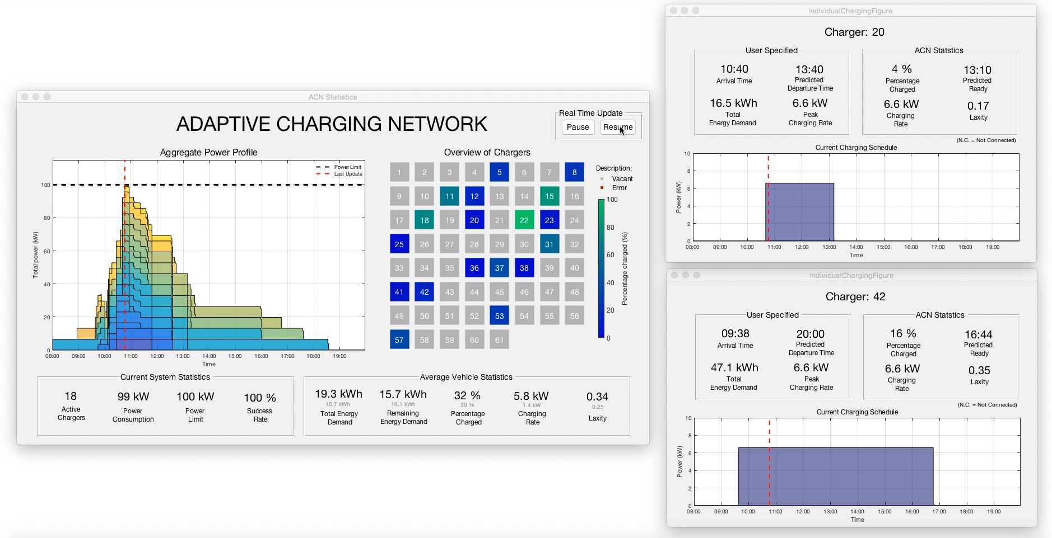
Simulation tool
Karl Erliksson 2016 SURF
Notes:
9:40

Slide 37
Backup Slides
Notes:
PowerFlex is a Caltech startup co-founded by George Lee and Steven Low
Dec 9, 2016: GlobalSIP, Washington DC (invited Meng Wang)

Slide 38
Daily peak power
without adaption
Daily peak power
with adaptation
data: CAgarage2016
ACN benefit
Caltech data (Feb – May, 2016)
savings = infrastructure, demand charge
Notes:
The transformer capacity is 7.2 kW (25 kW shared between 4 houses). Each car can charge at a peak rate of 7.2 kW. Therefore all three cars charging at their peak rate will exceed the transformer limit.
The demo will run over 11 minutes with the following scenario:
Three cars will be plugged in at different times with different energy demands and departure times:
Car 1: arrives at time 0, departs at time 11 mins, needs 0.71 kWh.
Car 2: arrives at time 2 mins, departs at 5 mins, needs 0.36 kWh.
Car 3: arrives at time 3 mins, departs at 8 mins, needs 0.25 kWh.
The scenario is designed to illustrate the importance of smart charging (and other system functions; see below):
Dumb charging where each car charges at its peak will exceed transformer limit.
Static sharing policy will not satisfy EV energy demands.
Only dynamic adaptation based on real-time information can work, as shown in the diagram below.

